Slide 1

Feasibility and Implications of M&A
Name of the Presenter: Sujit Sircar Date: 26th Aug 2011

Slide 2
Approach for M&A
Move from an acquisitions strategy, to acquisition as the manifestation of strategy
Strategic Fit
Pre-Conditions for Success
Pre-Merger Discussions
Post-Merger Integration
Don’t let acquisitions determine your strategy
A ready meeting of minds on what business is about
A model to improve both parties’ competitive position
Focusing on how the model will work
Agreeing a price where both benefit
Demonstrating “success without a heavy hand”
Re-establishing the Governing Objective

Slide 3
Value creating external growth
Creating value via external growth requires a combination of three critical elements:
Good Strategic Fit
Good Acquisition
Economics
Pro-active and Rapid Integration
Highest odds of
creating value
Beware: - Traditional measures of industry/market attractiveness
- Revenue side synergies
- Acquisition proposals with little or no integration plan

Slide 4
Reasons for Acquisitions
Increased Market Power
Acquisition intended to reduce the competitive balance of the industry
Example: British Petroleum’s acquisition of U.S. Amoco
Overcome Barriers to Entry
Acquisitions overcome costly barriers to entry which may make “start-ups” economically unattractive
Example: Belgian-Dutch Fortis’ acquisition of American Banker’s Insurance Group
Lower Cost and Risk of New Product Development
Buying established businesses reduces risk of start-up ventures
Example: Watson Pharmaceuticals’ acquisition of Thera Tech
Notes:
11

Slide 5
Reasons for Acquisitions
Increased Speed to Market
Closely related to Barriers to Entry, allows market entry in a more timely fashion
Example: Kraft Food’s acquisition of Boca Burger
Diversification
Quick way to move into businesses when firm currently lacks experience and depth in industry
Example: CNET’s acquisition of mySimon
Reshaping Competitive Scope
Firms may use acquisitions to restrict its dependence on a single or a few products or markets
Example: General Electric’s acquisition of NBC
Notes:
17

Slide 6
Problems with Acquisitions
Integration Difficulties
Differing financial and control systems can make integration of firms difficult
Example: Intel’s acquisition of DEC’s semiconductor division
Inadequate Evaluation of Target
“Winners Curse” bid causes acquirer to overpay for firm
Example: Marks and Spencer’s acquisition of Brooks Brothers
Large or Extraordinary Debt
Costly debt can create onerous burden on cash outflows
Example: AgriBioTech’s acquisition of dozens of small seed firms
Notes:
23

Slide 7
Problems with Acquisitions
Inability to Achieve Synergy
Justifying acquisitions can increase estimate of expected benefits
Example: Quaker Oats and Snapple
Overly Diversified
Acquirer doesn’t have expertise required to manage unrelated businesses
Example: GE--prior to selling businesses and refocusing
Managers Overly Focused on Acquisition
Managers may fail to objectively assess the value of outcomes achieved through the firm’s acquisition strategy
Example: Ford and Jaguar
Too Large
Large bureaucracy reduces innovation and flexibility
Notes:
30

Slide 8
Attributes of a successful acquisition
Create a Superior Growth Organisation
Establish the right objectives at all levels
Establish the boundaries that maximise clarity and accountability
Establish value based management processes
Establish value based information systems
Develop management capabilities for creating value
Lead by example
Constantly pursue higher value portfolio strategies
Constantly pursue ways to exploit affiliation benefits
Constantly prune unprofitable activities at the Centre
Enforce the Governing Objective
Intervene with business units to stimulate higher value alternatives
Intervene with business units to eliminate unprofitable use of resources
Intervene with business units to ensure there are consequences for non-conforming behaviour

Slide 9
M&A Trends in Technology Sector
YTD 2011, M&A activity in Technology sector has been strong
881 Companies got acquired within first quarter of 2011 for total value of ~$84 billion, highest level of activity seen in Tech sector (in terms of number of deals) after second quarter of 2008
Primary areas where consolidation / acquisition activity is strong are cloud computing, social networking, e-commerce, m-commerce and information security
M&A activity on average happened at Price to Revenue ratio of around 1.6 – 1.7 and Price to EBIT ratio of 18.0 – 19.0
M&A outlook for remaining year 2011 is extremely positive and few more mega deals are likely to get announced

Slide 10
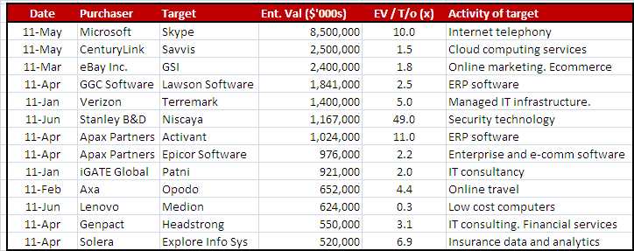
Biggest deals of 2011 so far

Slide 11
M&A Trends in Indian Technology Sector
FY2011 saw 120 deals with disclosed value of ~$2 billion, a jump of 49% over FY2010
IT-enabled services were the primary driver of M&A activity though there were couple of large deals on IT services side e.g. iGATE buying Patni, Mphasis acquiring Wyde Corporation
Indian IT companies were involved in 120 M&A transactions in FY2011 with 55 being Domestic (between Indian companies), 32 inbound (Foreign company acquiring Indian Company) and 33 outbound (Indian Company acquiring foreign company)
U.S. and U.K. were the primary destinations for Outbound M&A activity
Almost all the big Indian IT companies are looking at inorganic route to fill gaps in their service offerings, to build non-linearity (by buying platforms, products, frameworks etc.) in their revenues, in new service areas such as Infrastructure Management, Cloud Computing etc.
Mid Sized companies are likely to face tough times and would be potential targets for foreign and other Indian IT companies
On the outbound side, rising protectionism threats could compel Indian IT companies to seek strategic acquisitions to quickly build local capability

Slide 12
Highlights of New Takeover Regulations:
Increase in threshold limit from 15% to 25%. It seems to be beneficial from the point of Private Equity and Institutional investors who had to restrict themselves to 14.99% stake in every listed company in terms of existing regulations and also for the Companies raising funds from Private Equity and Institutional investors.
Increase in Offer Size from 20% to 26%.This is owing to industry pressure against the 100% offer size. Its good move from the point of view of domestic promoters and industry as the cost concerns and funding of offer is addressed to a major extent.
Abolition of Non-compete fees. SEBI has accepted the TRAC recommendation of scrapping the non-compete fee. Outright scrapping may not be treated as a right move as the Promoters cannot be treated at par with the general public shareholders specifically where the promoters have real personal contribution in business.

Slide 13
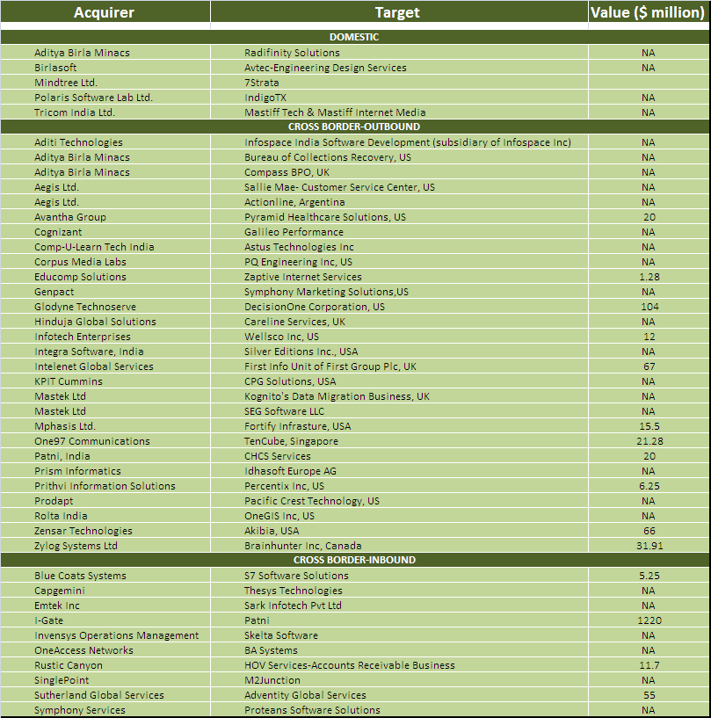
M&A activity involving Indian companies in FY2011 - Nasscom

Slide 14
Thank You

